Slide 1
Credit Default Analysis Proposal
John Abbott
R and Powerpoint Sample

Slide 2
Background
2008-2009 revealed some outdated financial practices
Defaulted loans incur a loss to the company equal to 150% of the original balance
The company’s revenue comes from loan payments
The goal is to predict whether a loan applicant will default
Notes:
So here’s the situation. The financial crisis of 2008-2009 revealed that many of the practices we use to evaluate loan applications to be outdated and largely ineffective for the scale of business and economics we are faced with today. For this reason we need to rethink how we go about evaluating loan applications.
Here are a few things we need to understand to form the basis of this evaluation. Firstly, defaulted loans incur a loss to the company equal to 150% of the original balance. Now I won’t go into the financial mechanics of how that happens, just understand that if the company grants a loan to an applicant, and the applicant fails to pay it off, the company loses one and a half times that much money. We would really like to avoid that.
At the same time, we want to grant loans to good applicants because that’s where our revenue comes from. So we don’t want to be too shy about loans. We just need a better way to predict when a default will happen.

Slide 3
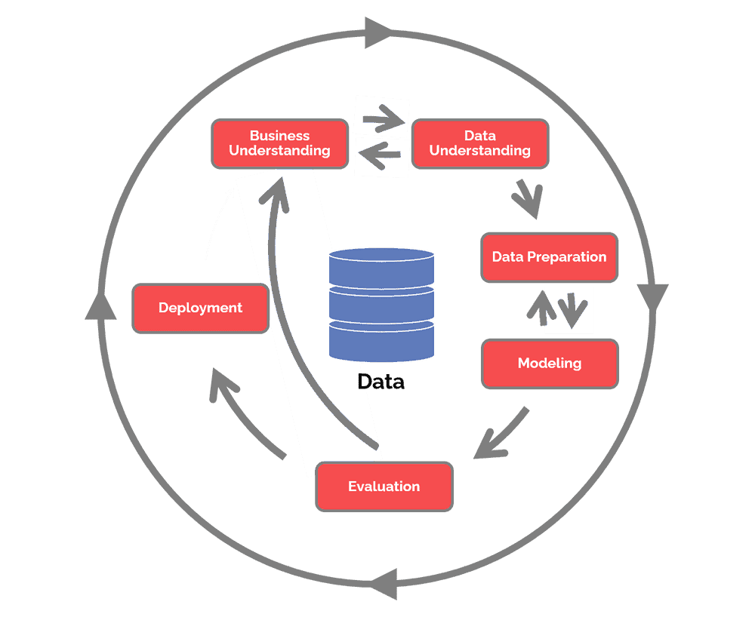
Data and CRISP-DM
https://www.datascience-pm.com/crisp-dm-2/
Notes:
The method designed for enterprise data analytics is called CRISP-DM. This is what we call a data analysis lifecycle, and the reason it’s going to be valuable to the company is because it accounts for the specific needs of the business. You can see the cycle starts with business understanding, and then moves onto data understanding. This is the essence of CRISP-DM. To contextualize our data and our analysis to answer the questions that we want to answer in this company. You know, we can extrapolate all sorts of numbers from data, and that’s great but numbers don’t tell a story on their own. Only when we contextualize the math, even when the math is quite advanced, do we start answering questions. So we’re going to use this life cycle to answer the question: How do we predict whether an applicant is going to default? And we’re going to continue to repeat this life cycle until we are certain we’ve answered this question, and are ready to deploy.

Slide 4
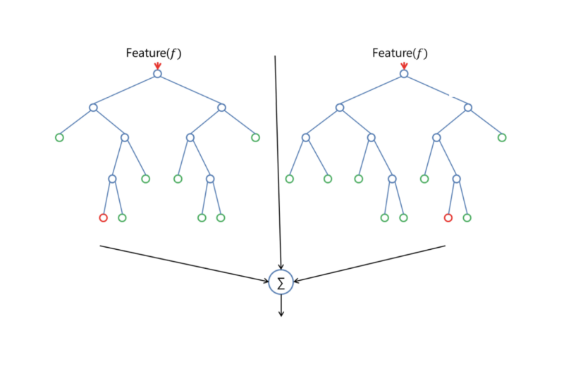
The Data and the Model
1000 past applicants
31 Variables
The Descriptive Model
The Predictive Model
The Random Forest
https://builtin.com/data-science/random-forest-algorithm
Notes:
This is our data understanding and the model informed by it. We have 1000 past applicants and 31 variables that describe them, such as savings account value, credit history, loan purpose, income, things like that. Now we’re not going to take every one of those variables into account because we want to make our model accessible and readable, and just as well, it turns out that most of those variables turn out not to be too strong of predictors. But more on that later.
When talking about a descriptive model versus a predictive model, what we’re talking about is describing the data and then using it to make descriptions. Descriptive models we’ll be using here are pretty simple, like what’s the average savings account value and how often do applicants default overall? It’s about 30% of the time… again, more on that later…
Our predictive model is the one that really gives us power, and for it we’re going to be doing what’s called a Random Forest. Perhaps you’ve heard of decision trees? If you haven’t, they’re basically branching pathways that inform a step by step decision making process. A Random Forest is a massive extension of that where a program generates a massive number of decision trees at random, and each one has calculations based on algorithms that it applies to the data, and the end result is this sort of averaging of all these forests which tells us how strongly each variable correlates to a target variable, in this case our target variable is “did they default?”
The reason this model is so great for our purposes is because it lets us evaluate each variable, essentially every little thing we know about the applicant, and score them based on how strongly they predict the default. That way, when we test applicants on the model, we’ll be able to make a prediction.

Slide 5

Tools: R and Rattle
Notes:
The digital tools we’re using to construct the model are really great. R is a scripting language designed specifically for data analytics, and rattle is a package within R. Now without going into how they work too much, I just wanted to sing R’s praises for a moment. To analysts like me who are very mathematically minded, R is fantastic. It has tons and tons of powerful capabilities for analysis, so that’s what we’re using to generate the forest. I really recommend that the IT team get involved with integrating R and the rattle package into the company’s toolset.

Slide 6
Variables
Checking Account (CHK_ACCT)
Loan History (HISTORY)
Savings Account (SAV_ACCT)
Do they have a Guarantor? (GUARANTOR)
Is there a co-applicant? (CO_APPLICANT)
Is their purpose retraining? (RETRAINING)
Is their purpose education? (EDUCATION)
Did the loan default? (DEFAULT)
Notes:
Here are the variables that were identified to be the strongest predictors of whether an applicant will default, according to the analysis. In parenthesis here I’ve written what they variables are written as on the spreadsheet just so you know what that looks like.
The value of their checking account
Their loan history, how good have they been in the past on their loans
The value of their savings account
Whether they have a guarantor or a co-applicant
Is their purpose retraining?
Is their purpose education? These turned out to be effect, somewhat surprisingly, over the other purposes which didn’t seem to matter.
At the bottom here is our target variable, did they default? That’s what we’re comparing all these above variables to, to assess their correlation. This is the great thing about the Random Forest. We just throw these at the Forest, and tweak a fair bit using the math to improve the results as much as we can, and it gives us a lovely confusion matrix that we can use to determine how good our predictions are going to be.

Slide 7
Additional Variables
Credit Score
Multiple banks
Multiple accounts
Notes:
Here are some other variables we may want to consider collecting from each applicant that could be good predictors. Naturally credit score is a good one. I also think that having multiple banks or multiple accounts in one bank beyond just savings and checking may be a good indicator, but mainly the credit score I think will really help us here.

Slide 8
Ethics
Age
Marital Status
Property Ownership
Notes:
So a quick word about Ethical Analysis. We chose not to include certain variables that were collected in the analysis for ethical reasons, mainly pertaining to the possibility of racial or cultural discrimination. While these may be decent indicators, we really don’t want to analyze them for the possibility of rejection because they aren’t ethical considerations for us to make. So we’ve excluded these and a few others.

Slide 9
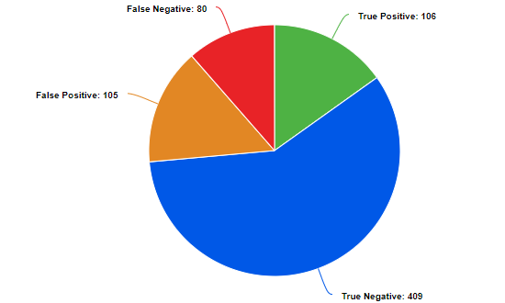
Predictive Testing
Notes:
Now for the results of the pilot test! This is of 700 entries in what we call a testing set. When you test a model you can’t do the entire dataset because that causes issues with validation so you have to take a random sample that simulates a group of people outside of our control. So of 700, here’s how each prediction came out.
About 26% of the time we guessed wrong. Now that’s pretty good, but the news gets better. Here you can see how heavily the True Negative outweighs the False Negative. That means that about 84% of the time, we were able to say “This person will not default and will be a benefit to the company with their loan” and be right about it. That’s REALLY good, considering the impact of a default. It means that only 16% of the time do we actually suffer a loan default.

Slide 10
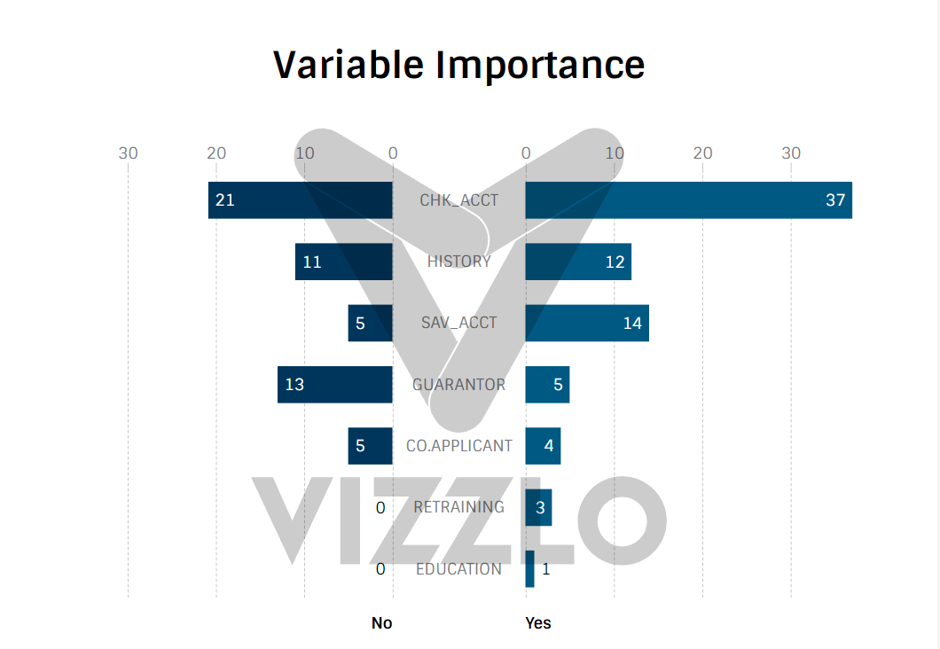
Variable Importance
Notes:
Here’s how each variable stacked up. To the right it measures the impact on the prediction that the applicant WILL default, and on the left it measures the impact on the prediction that they WILL NOT default. I won’t go too deep into what the numbers mean exactly, but think of them like parts in a drink. It’s sort of a proportionate amount.
Looking at the applicant’s accounts was very strong, whether the account was high or low. And as we might expect, history was pretty strong too. Interestingly the presence of a guarantor really helped a lot of applicants pay off their loans, and having a Co-applicant helped them a little. Retraining and Education had just a small impact, but would never be the end all be all for an applicant. Just a small consideration there. Mostly the accounts and the history were huge predictors, which is really nice because that’s something we can easily look at.

Slide 11
Value
Reduce our default rate to about 16%
This translates to recovering over 75% of the revenue lost to loan defaults
Notes:
So what value does this present to us exactly? Well, we can use this model to reduce our default rate to about 16% of the applicants we do accept. Assuming our baseline is just guessing at a 50/50, maybe we try to use a few variables and our intuition to improve that a little… using this model instead lets us reclaim over 75% of the revenue we would normally lose from loan defaults.

Slide 12
Questions?

